Slide 1
Machine Learning with Java? Deeplearning4j!
Enrique Llerena Dominguez
Java Forum Stuttgart 2020

Slide 2
$whoami
Enrique Llerena Dominguez
Senior Software Engineer / Consultant @ mimacom
Experience developing software for the finance, retail, pharma, and automotive industry
Professional Interests: Software Architecture, Cloud Computing, Artificial Intelligence
Free Time: Spending time with my kids, watching football, learning german, and developing nice things

Slide 3
Enrique Llerena Dominguez
Twitter @ellerenad
Github @ellerenad
enrique.dominguez@mimacom.com

Slide 4
Enrique Llerena Dominguez
Twitter @ellerenad
Github @ellerenad
enrique.dominguez@mimacom.com

Slide 5


Slide 6
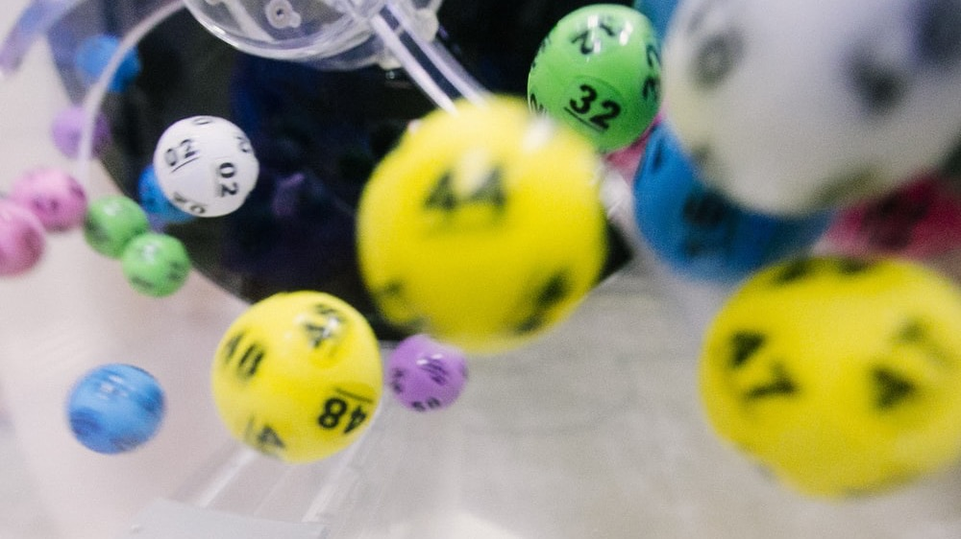
Image source: Photo by dylan nolte on Unsplash

Slide 7
Agenda
Machine Learning 101 + deeplearning4j
Deeplearning4j integrations
Hands on examples:
Image classification – Approach and code
Sentiment analysis – Approach and code

Slide 8
What is Machine Learning?
Machine Learning is the study of computer algorithms that improve automatically through experience
Source: Mitchell, T. (1997), Machine Learning. http://www.cs.cmu.edu/~tom/mlbook.html , retrieved 08.2020

Slide 9
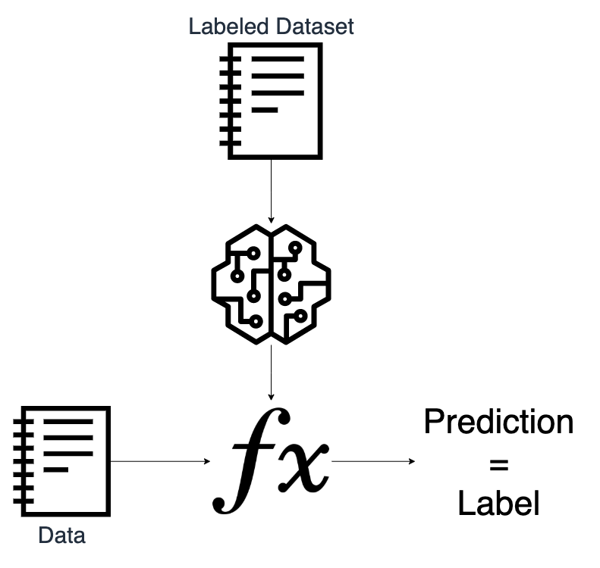
What is Machine Learning?

Slide 10

What is Deeplearning4j?
Open-source deep-learning library written for Java and Scala

Slide 11
Story time!
Iris classification AKA the “Machine Learning Hello World”

Slide 12

Peter the biologist
Image source: Photo by Alex on Unsplash

Slide 13
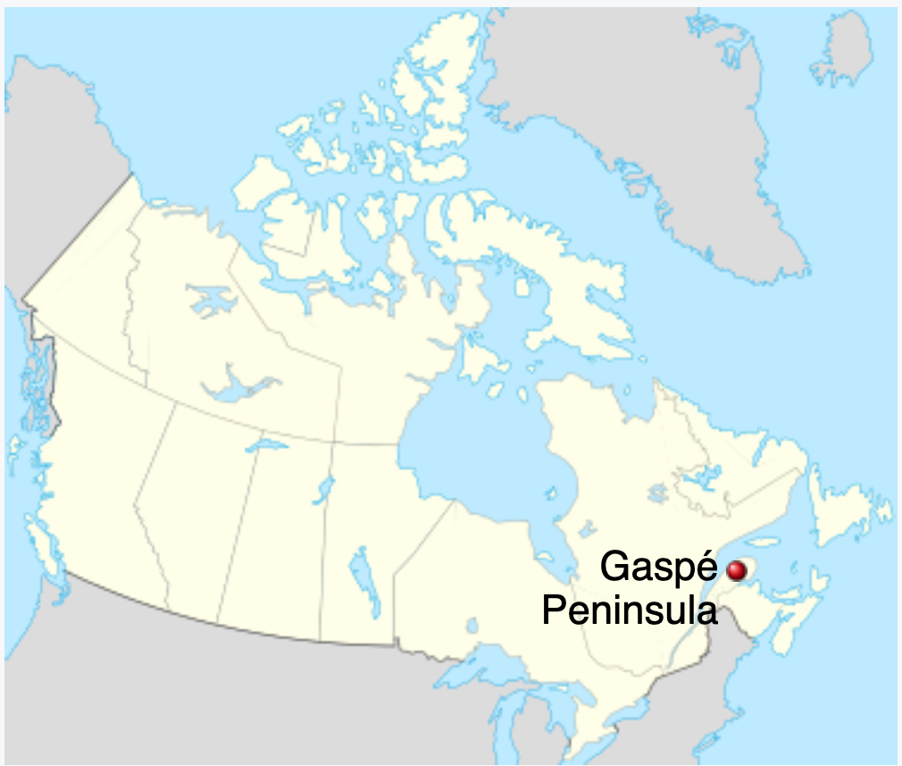
Image source: https://en.wikipedia.org/wiki/Gasp%C3%A9_Peninsula

Slide 14
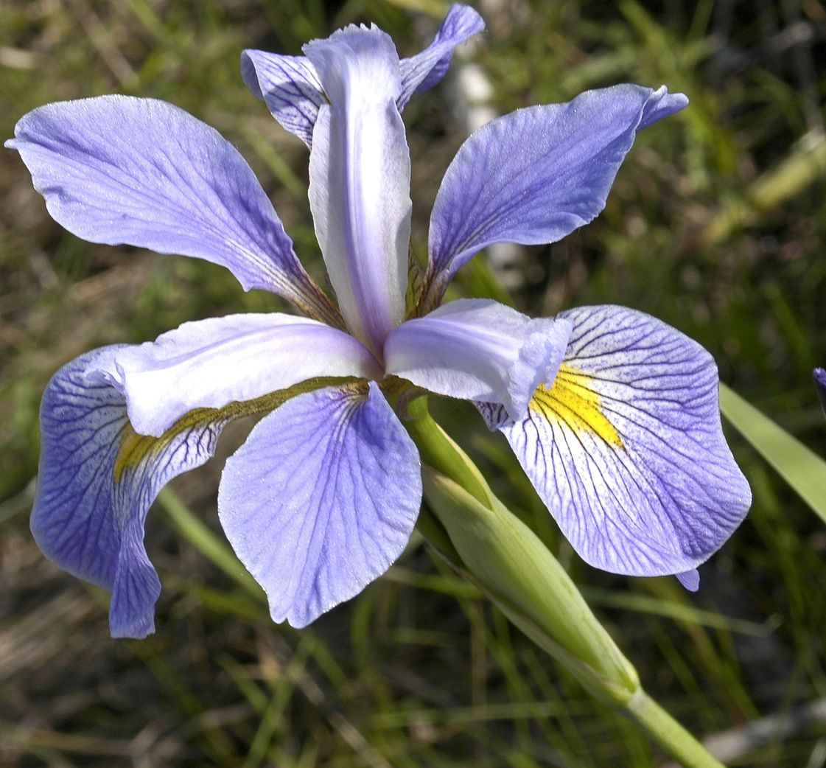
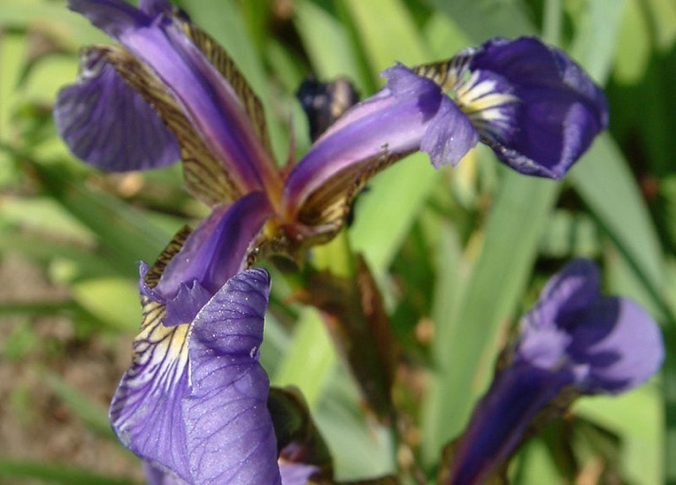
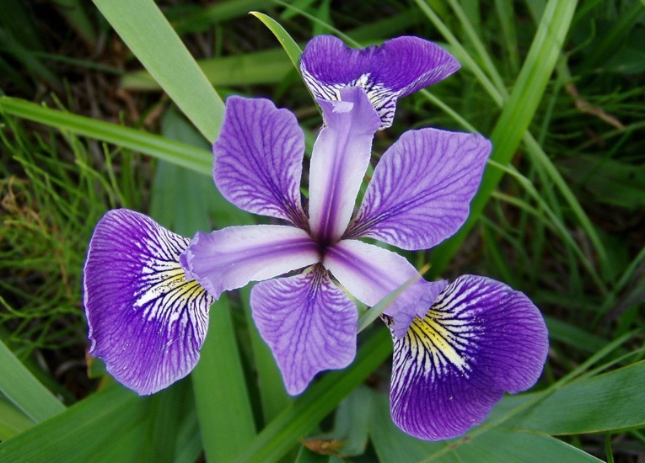
Images source:https://en.wikipedia.org/wiki/Iris_flower_data_set

Slide 15
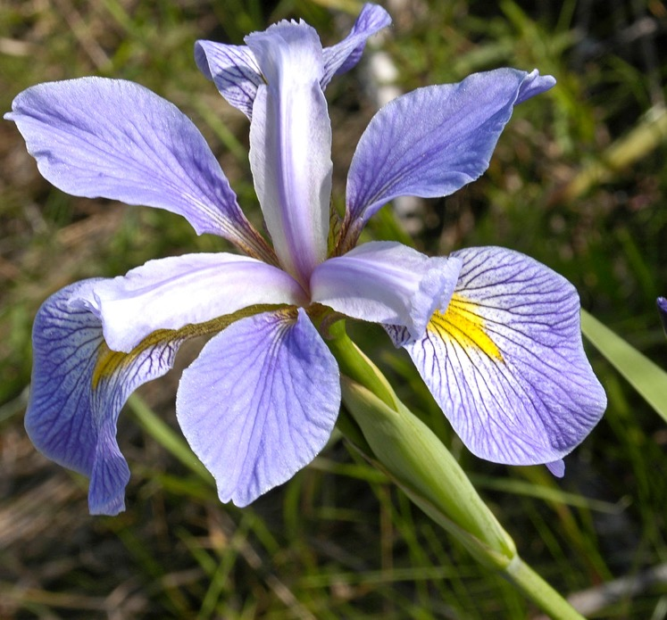

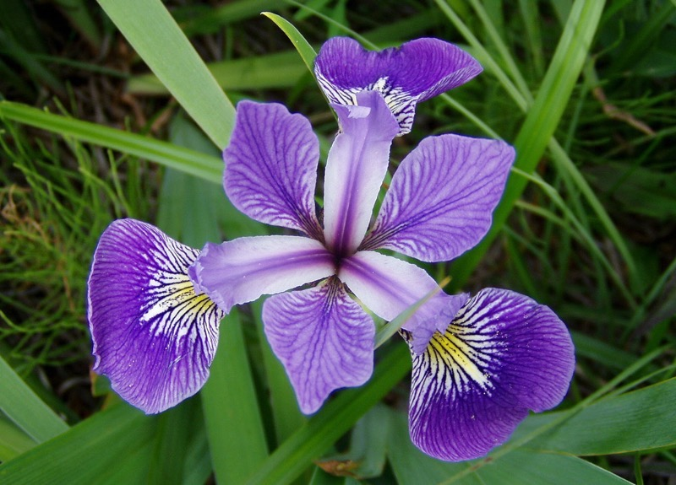
Iris Setosa
Iris Virginica
Images source: https://en.wikipedia.org/wiki/Iris_flower_data_set
Iris Versicolor

Slide 16
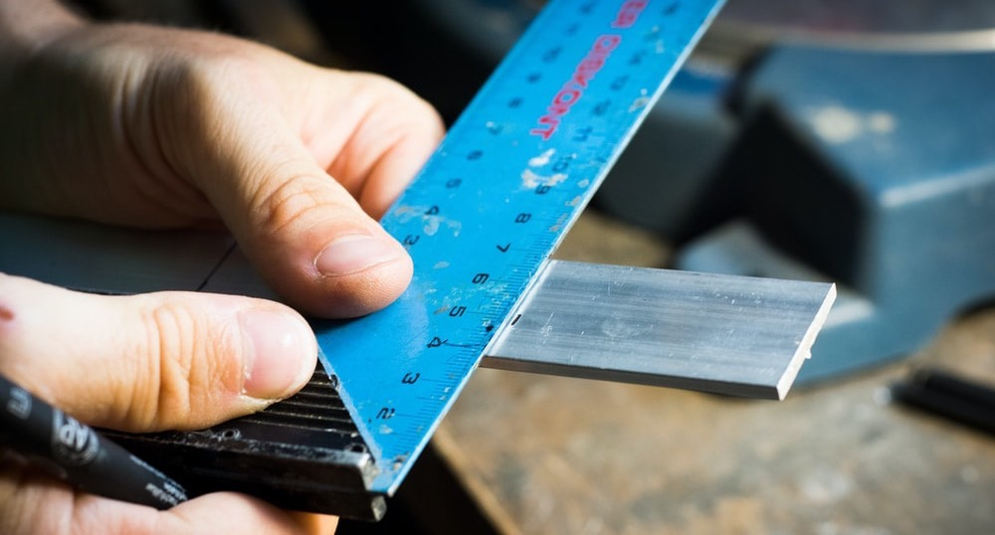
Image source: Photo by Blaz Erzetic on Unsplash

Slide 17

Images source: Photo by Ben Mullins on Unsplash

Slide 18
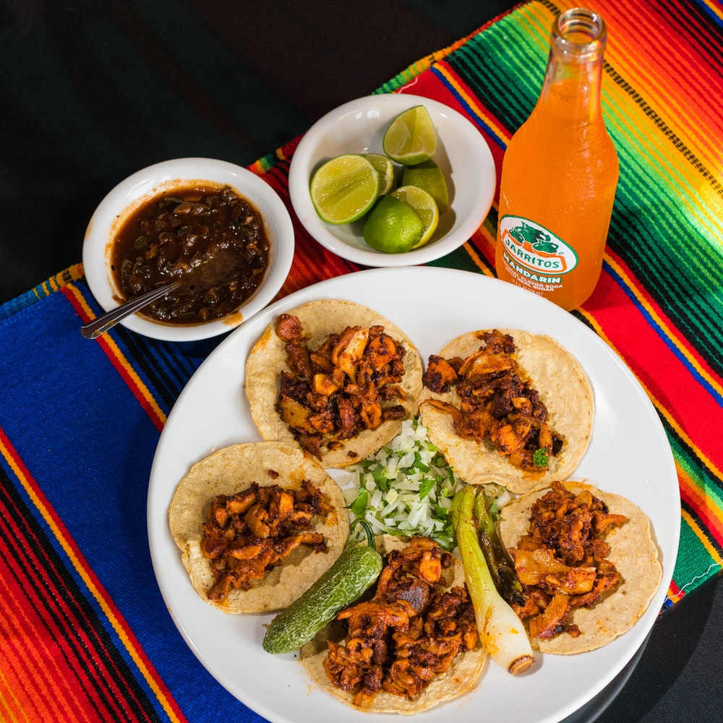
Images source:Photo by Jarritos Mexican Soda on Unsplash

Slide 19
it would be really cool that someone else could classify this flower just by providing the measurements!
Image source: Photo by Alex on Unsplash

Slide 20
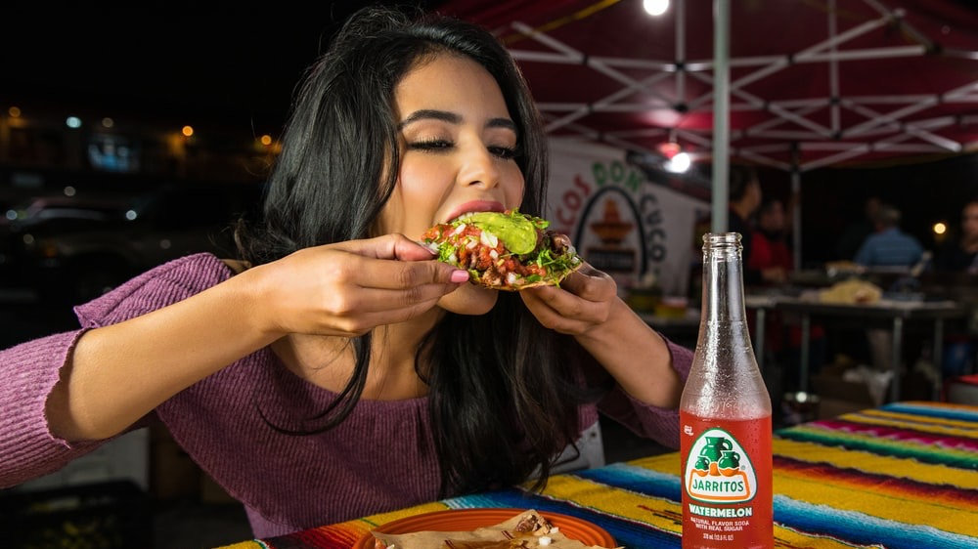
Teresa the software engineer, Peter’s daughter
Photo by Jarritos Mexican Soda on Unsplash

Slide 21
hey! I can automate that!
Photo by Jarritos Mexican Soda on Unsplash

Slide 22
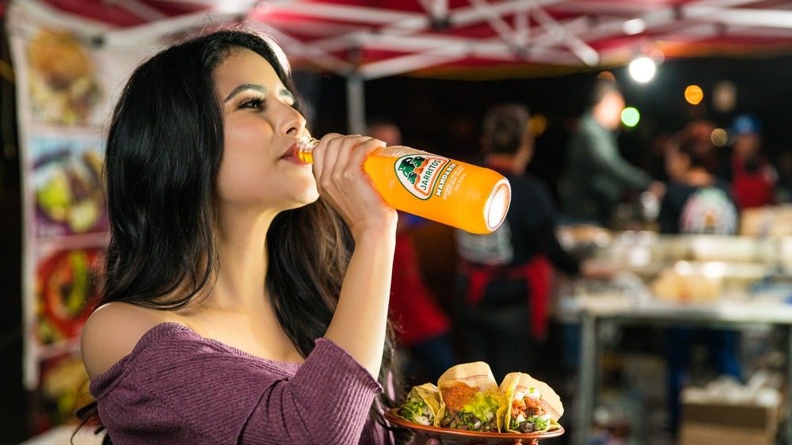
But first things first
Photo by Jarritos Mexican Soda on Unsplash

Slide 23

Photo by NESA by Makers on Unsplash

Slide 24



Resources
Labeled dataset
Images sources:
Photo by Ben Mullins on Unsplash
Deeplearning4j Logo https://github.com/eclipse/deeplearning4j
Java Logo, By Source (WP:NFCC#4), Fair use, https://en.wikipedia.org/w/index.php?curid=51298819
Maven Logo, By Apache Software Foundation - Apache Software Foundation http://maven.apache.org/images/maventxt_logo_200.gif, Attribution, https://commons.wikimedia.org/w/index.php?curid=10365467

Slide 25
Problem description
Type: Classification
Dataset:
Number of instances: 150
Number of attributes: 4
sepal length in cm
sepal width in cm
petal length in cm
petal width in cm
Number of classes: 3
Iris Setosa
Iris Versicolour
Iris Virginica
Source: University of California, Irvine , Iris Data Set. https://archive.ics.uci.edu/ml/datasets/iris , retrieved 08.2020

Slide 26
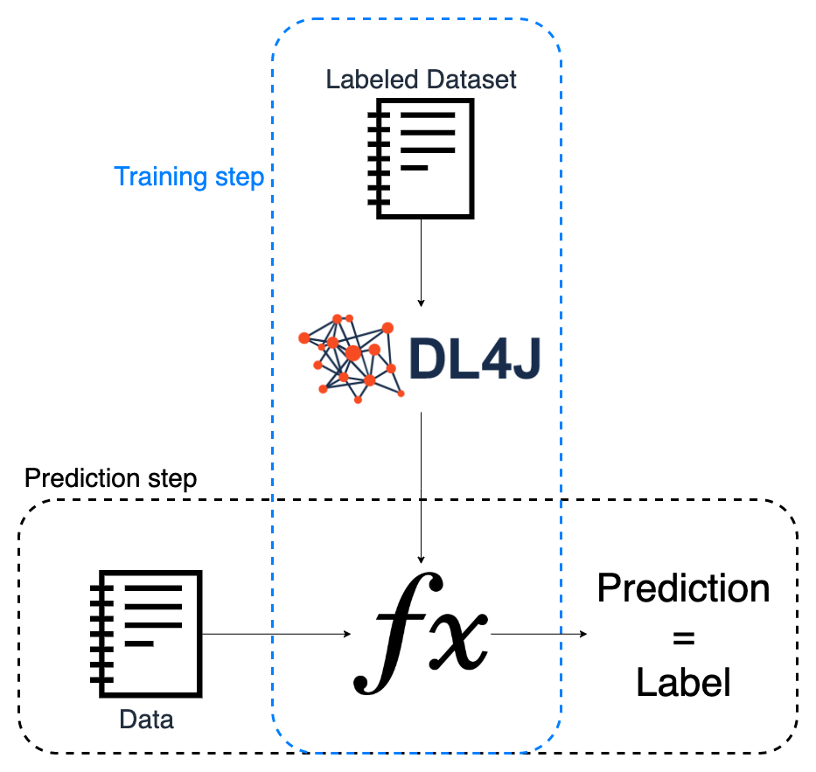

Slide 27
Training step
Load the dataset
Normalize the data
Split in train and test datasets
Configure the model
Train model
Evaluate the model
Export the model

Slide 28

Iris Classifier Trainer Most Valuable Code

Slide 29
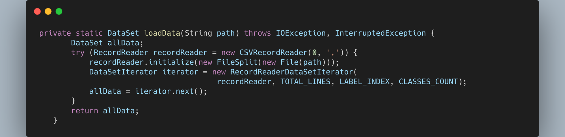
Load the dataset
Normalize the data
Split in train and test datasets
Configure the model
Train model
Evaluate the model
Export the model

Slide 30
Load the dataset
Normalize the data
Split in train and test datasets
Configure the model
Train model
Evaluate the model
Export the model

Slide 31
Load the dataset
Normalize the data
Split in train and test datasets
Configure the model
Train model
Evaluate the model
Export the model

Slide 32
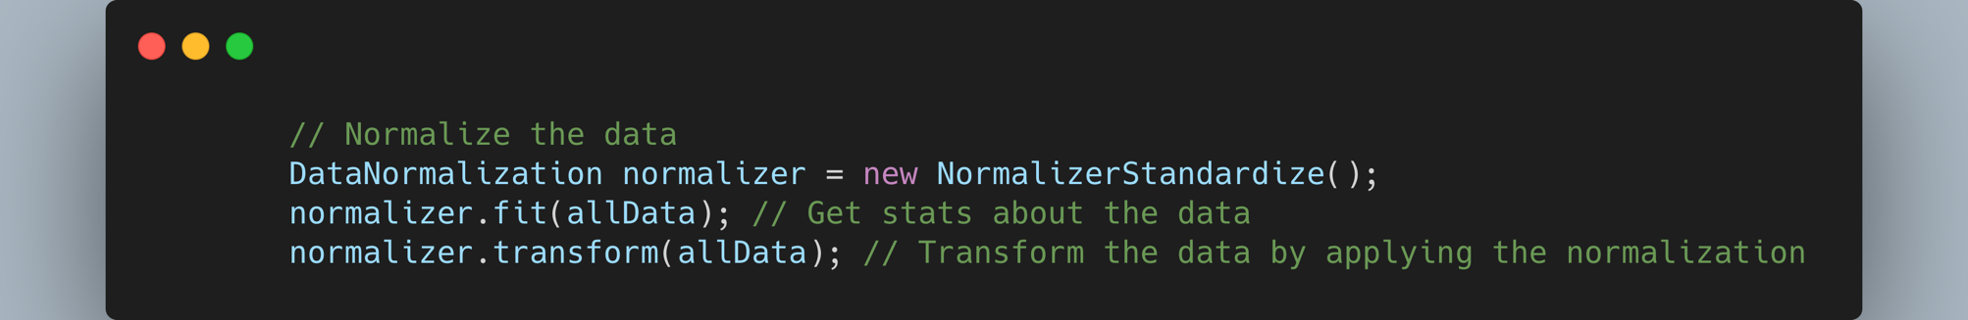
Load the dataset
Normalize the data
Split in train and test datasets
Configure the model
Train model
Evaluate the model
Export the model

Slide 33
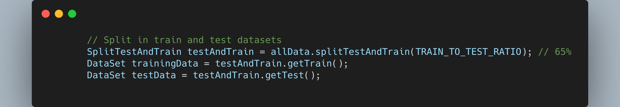
Load the dataset
Normalize the data
Split in train and test datasets
Configure the model
Train model
Evaluate the model
Export the model

Slide 34
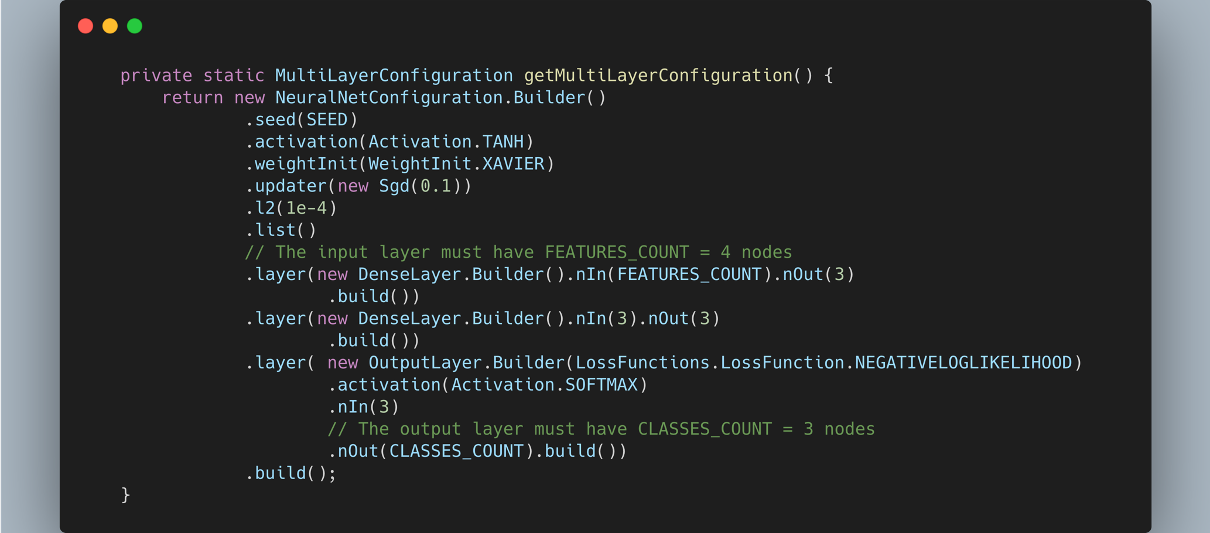
Load the dataset
Normalize the data
Split in train and test datasets
Configure the model
Train model
Evaluate the model
Export the model

Slide 35
Load the dataset
Normalize the data
Split in train and test datasets
Configure the model
Train model
Evaluate the model
Export the model

Slide 36
Load the dataset
Normalize the data
Split in train and test datasets
Configure the model
Train model
Evaluate the model
Export the model

Slide 37
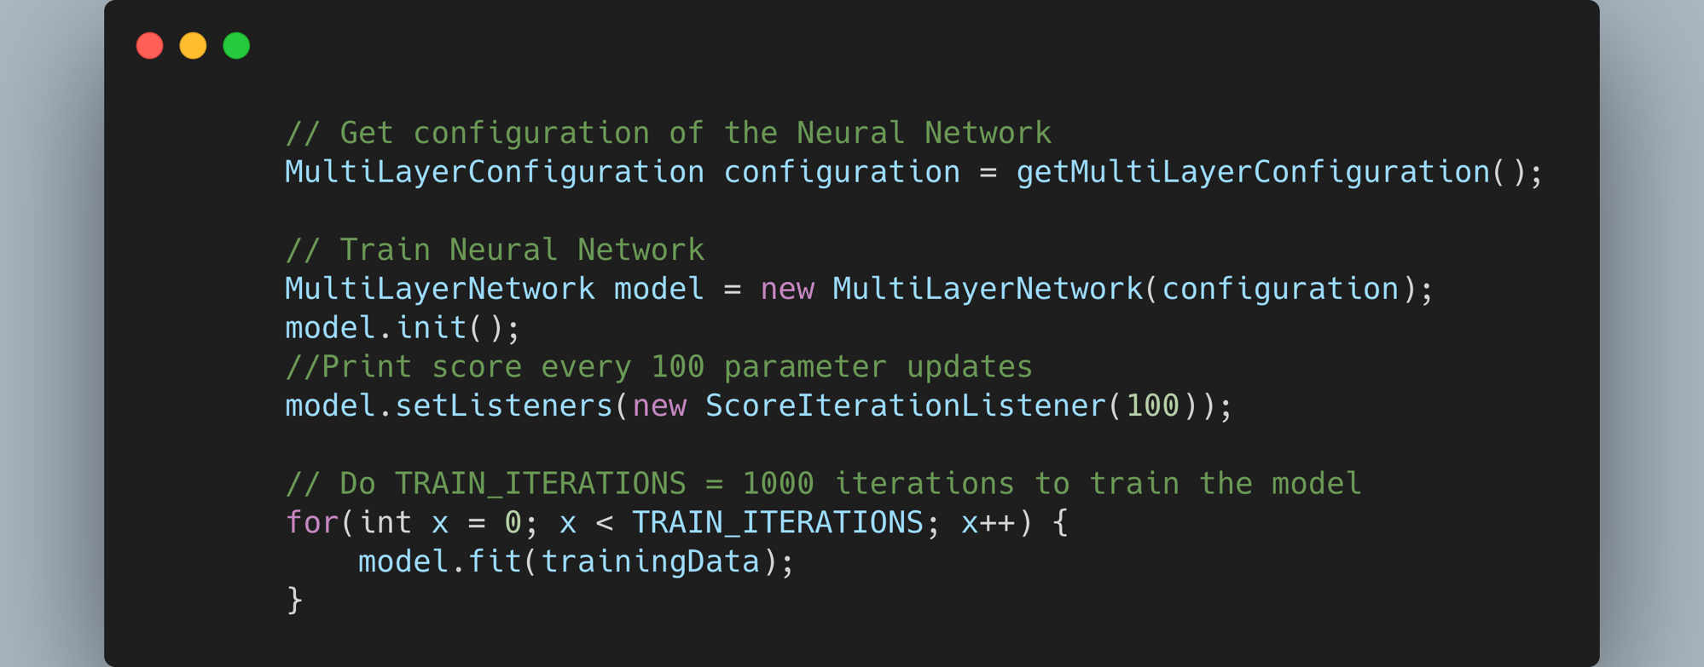
Load the dataset
Normalize the data
Split in train and test datasets
Configure the model
Train model
Evaluate the model
Export the model

Slide 38
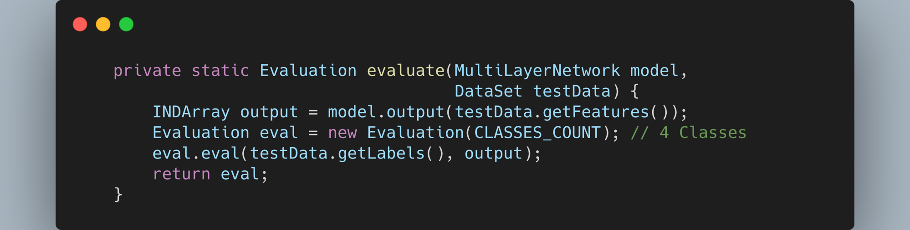
Load the dataset
Normalize the data
Split in train and test datasets
Configure the model
Train model
Evaluate the model
Export the model

Slide 39
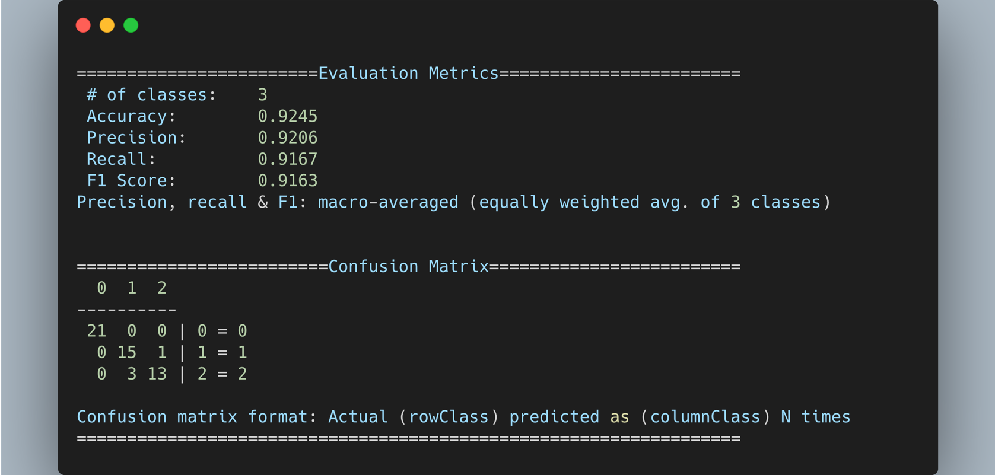
Load the dataset
Normalize the data
Split in train and test datasets
Configure the model
Train model
Evaluate the model
Export the model

Slide 40
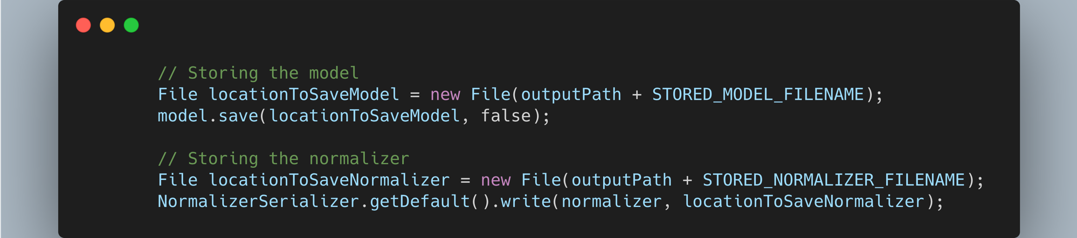
Load the dataset
Normalize the data
Split in train and test datasets
Configure the model
Train model
Evaluate the model
Export the model

Slide 41
Prediction step
Load the model
Normalize the data
Feed the data
Get the label
Format the data

Slide 42
Iris Classifier Predictor Most Valuable Code

Slide 43
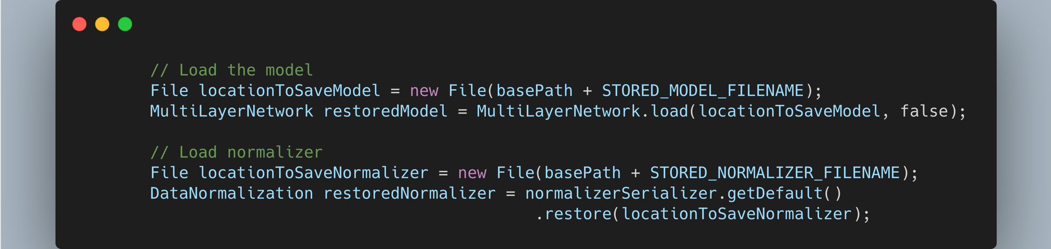
Load the model
Normalize the data
Feed the data
Get the label
Format the data

Slide 44
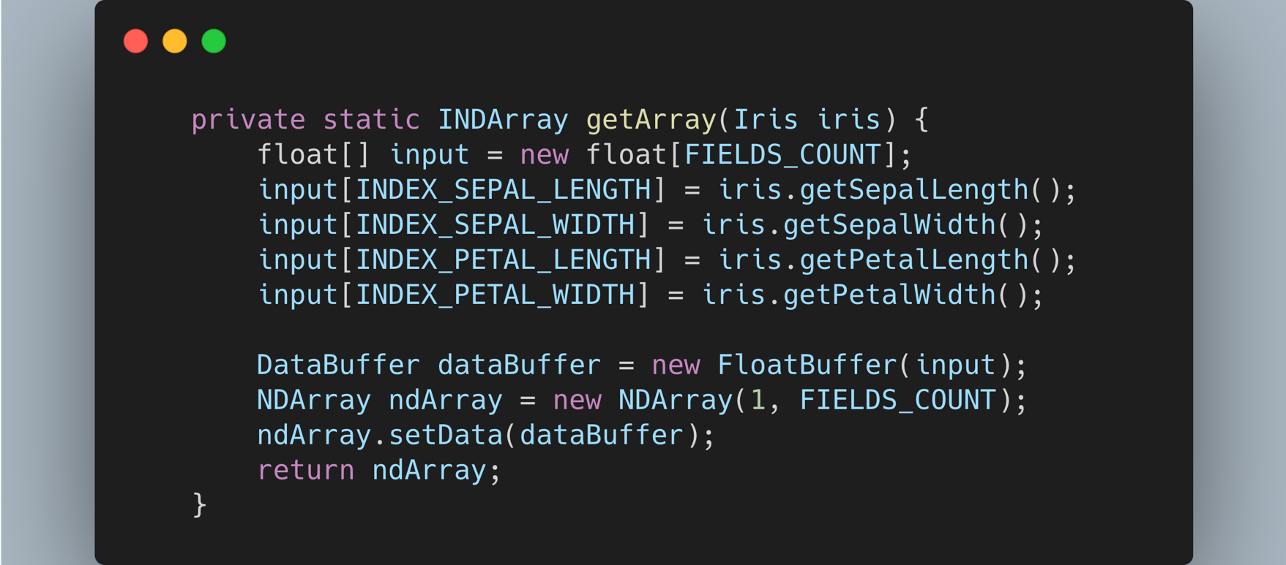
Load the model
Normalize the data
Feed the data
Get the label
Format the data

Slide 45
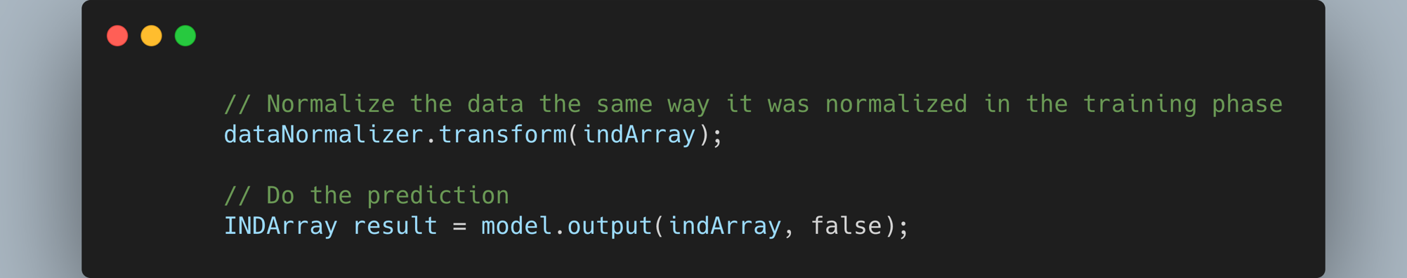
Load the model
Normalize the data
Feed the data
Get the label
Format the data

Slide 46
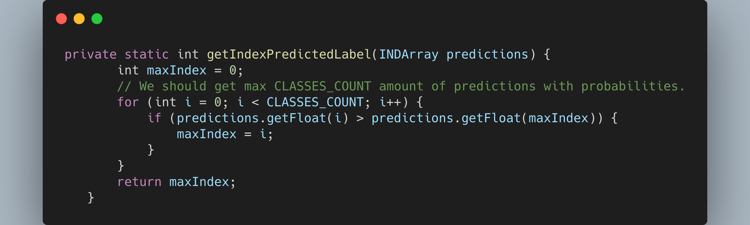
Load the model
Normalize the data
Feed the data
Get the label
Format the data

Slide 47
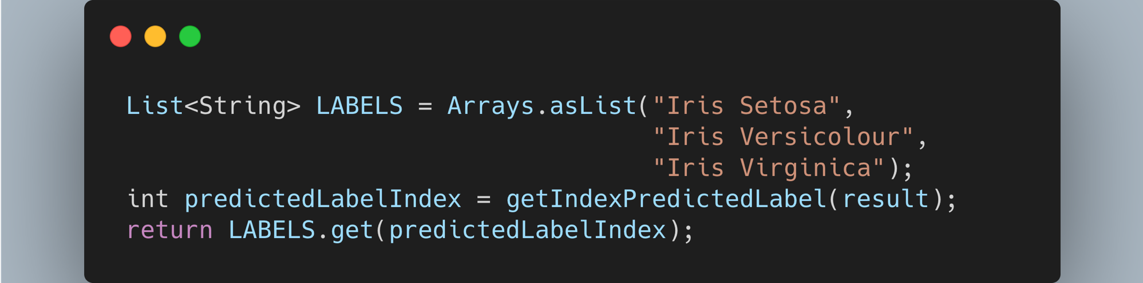
Load the model
Normalize the data
Feed the data
Get the label
Format the data

Slide 48
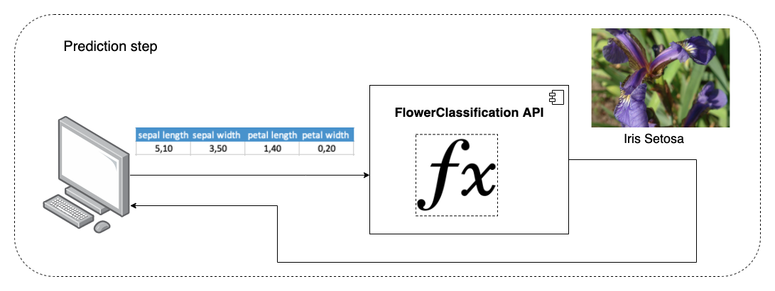

Slide 49
Peter is happy!
Now my friends can classify these flowers just by calling the FlowerClassification API with the measurements! :D

Slide 50
What did we learn?
2 main steps
Training
Input: Labeled dataset
Output: Trained model
Prediction
Input: Trained model + unlabeled data
Output: Prediction -> in this case, of type “classification”
How to use Deeplearning4j to train a model, export it, load it and perform a prediction

Slide 51
Machine Learning Approaches
Supervised
Classification
Regression
Unsupervised
Reinforcement learning
Source: Wikipedia, Machine Learning. https://en.wikipedia.org/wiki/Machine_learning , retrieved 08.2020

Slide 52
Machine Learning Approaches
Supervised
Classification
Regression
Unsupervised
Reinforcement learning

Slide 53
Machine Learning Algorithms
Examples:
Support Vector Machines
Linear regression
Logistic regression
Naive Bayes
Linear discriminant analysis
Decision trees
Neural Networks (Multilayer perceptron)
…
Source: Wikipedia, Machine Learning. https://en.wikipedia.org/wiki/Machine_learning , retrieved 08.2020

Slide 54


Deeplearning4j integrations
Distributed training
Images sources
Apache Spark logo, https://spark.apache.org/images/spark-logo-trademark.png
Apache Hadoop logo, https://hadoop.apache.org/hadoop-logo.jpg

Slide 55


Deeplearning4j integrations
Parallel training
Import models
Images source:
Keras logo, https://keras.io/img/logo.png
Nivida CUDA logo, https://en.wikipedia.org/w/index.php?curid=53650345

Slide 56
Deeplearning4j integrations
Keras is an open-source neural-network library written in Python. It is capable of running on top of TensorFlow, Microsoft Cognitive Toolkit, R, Theano, or PlaidML.
source:
Keras logo, https://keras.io/img/logo.png
Keras description, Keras, https://en.wikipedia.org/wiki/Keras , retrieved 08/2020

Slide 57
One step back

Slide 58
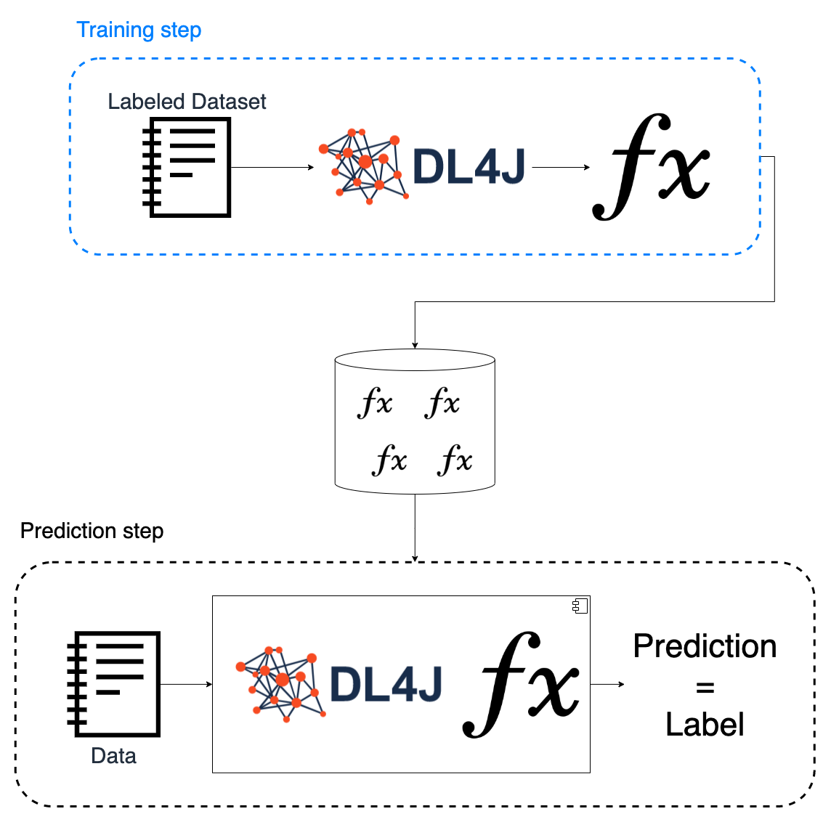
Decoupled in time!

Slide 59
* JVM Language

Slide 60

+
=
Flexibility

Slide 61
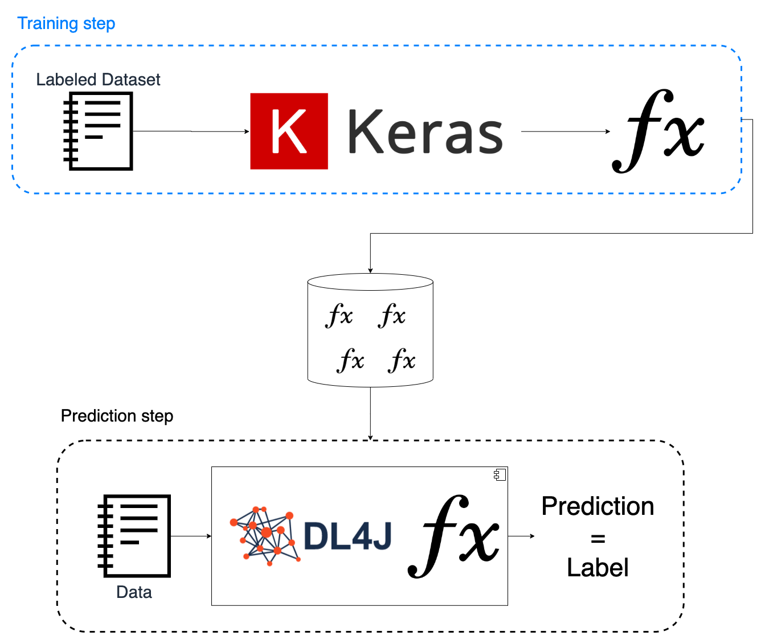


Slide 62

Deeplearning4j integrations
Enables the integration of people with different technical profiles
Opens the door to more pretrained models
+
=
Flexibility

Slide 63
Image Classification
Approach:
Deeplearning4j’s Model Zoo
OpenCV

Slide 64
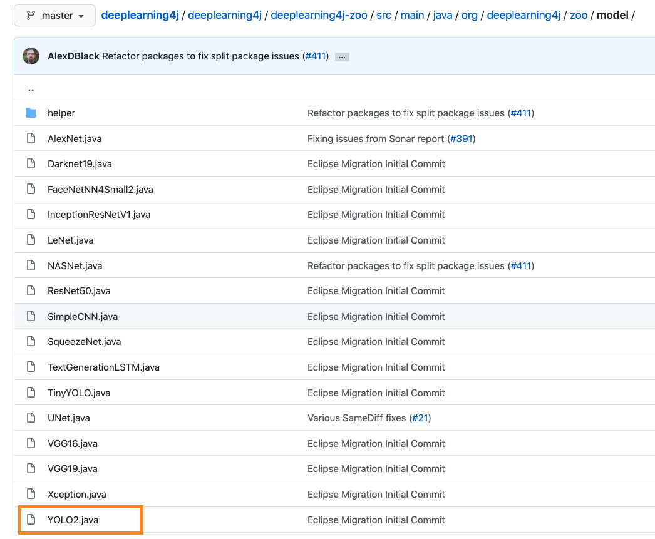
Deeplearning4j’s Model Zoo

Slide 65

Image source
Yolo Logo , https://pjreddie.com/media/image/yologo_2.png

Slide 66
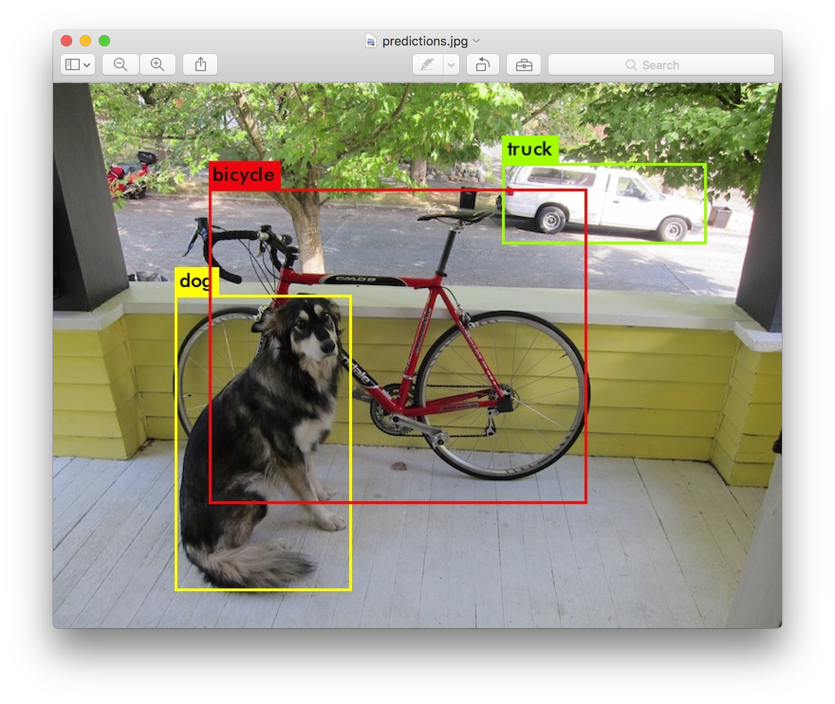
Image source
Yolo Example , https://pjreddie.com/media/image/Screen_Shot_2018-03-24_at_10.48.42_PM.png

Slide 67
YOLOv2 Available Labels
person | fire hydrant | elephant | skis | wine glass | broccoli | diningtable | toaster
bicycle | stop sign | bear | snowboard | cup | carrot | toilet | sink
car | parking meter | zebra | sports ball | fork | hot dog | tvmonitor | refrigerator
motorbike | bench | giraffe | kite | knife | pizza | laptop | book
aeroplane | bird | backpack | baseball bat | spoon | donut | mouse | clock
bus | cat | umbrella | baseball glove | bowl | cake | remote | vase
train | dog | handbag | skateboard | banana | chair | keyboard | scissors
truck | horse | tie | surfboard | apple | sofa | cell phone | teddy bear
boat | sheep | suitcase | tennis racket | sandwich | pottedplant | microwave | hair drier
traffic light | cow | frisbee | bottle | orange | bed | oven | toothbrush

Slide 68

Steps overview
Load model from Zoo
Load image
Preprocess image
Feed the model
Get detected objects
Annotate original image

Slide 69
Yolo2ImageClassifier - Most Valuable Code

Slide 70
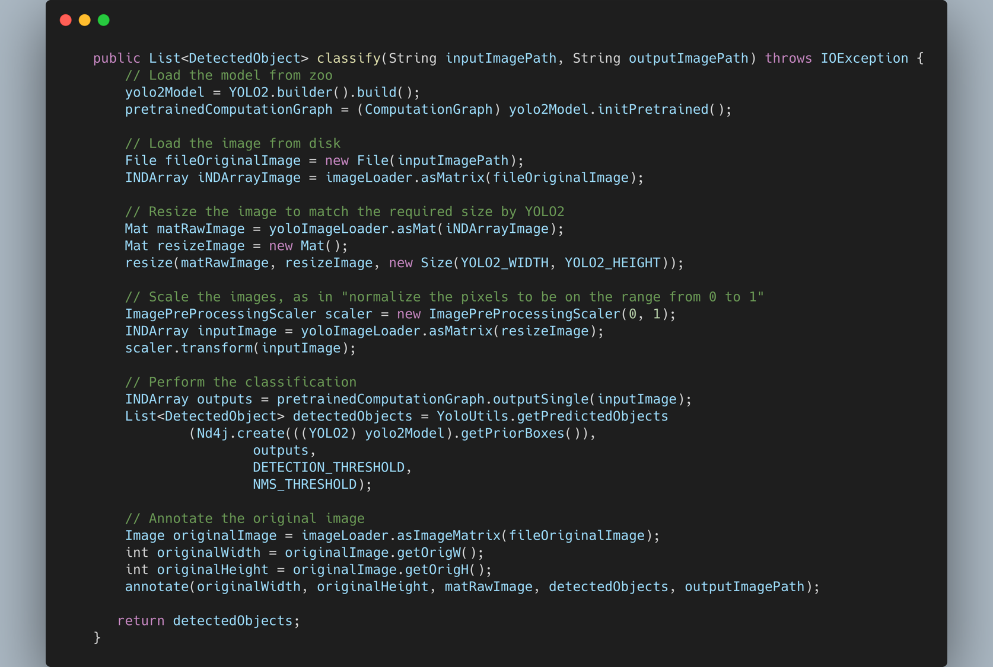

Slide 71
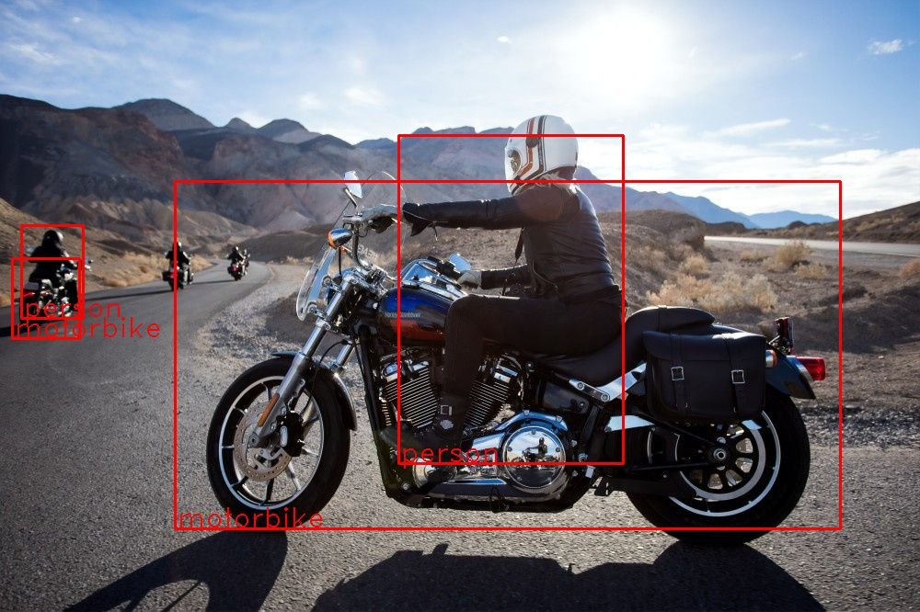
Image source: unsplash. Annotated by myself using yolo2

Slide 72
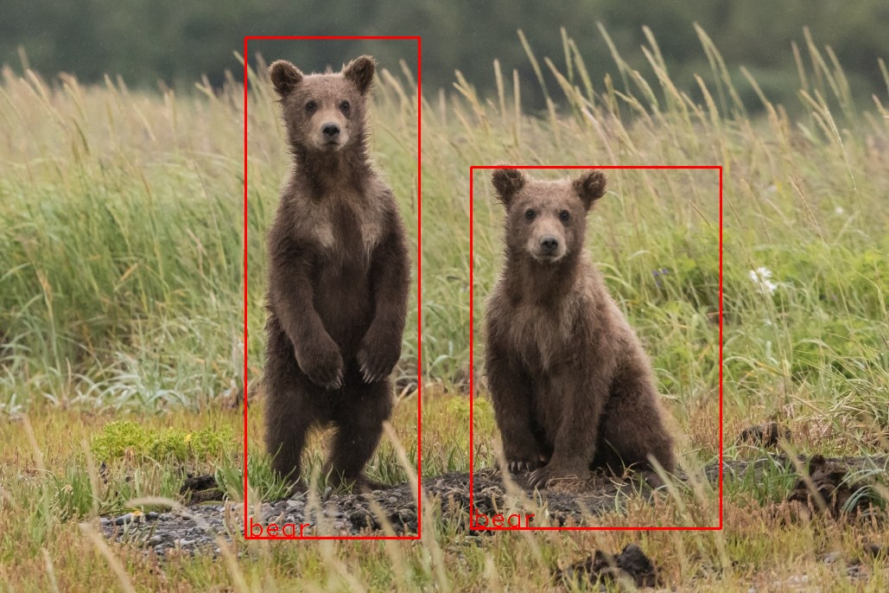
Image source: unsplash. Annotated by myself using yolo2

Slide 73
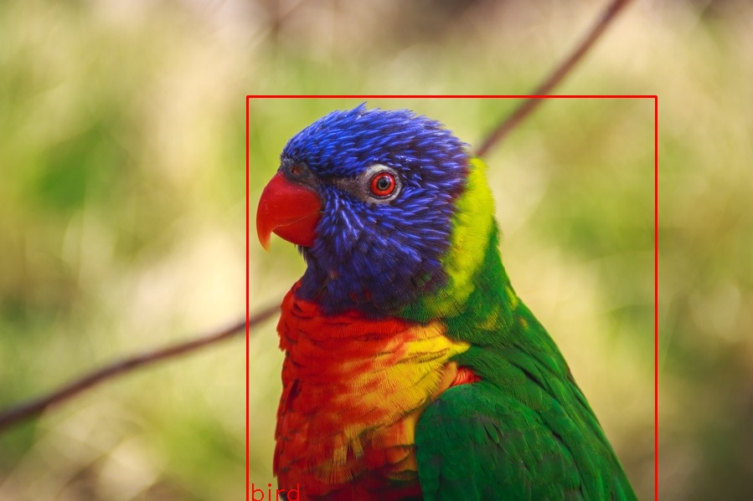
Image source: unsplash. Annotated by myself using yolo2

Slide 74
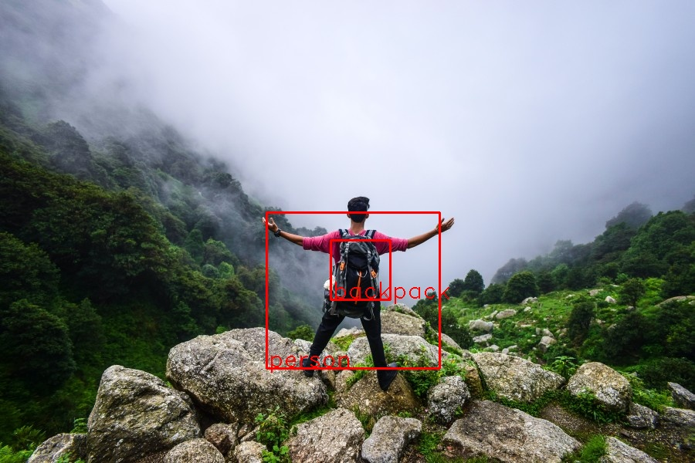
Image source: unsplash. Annotated by myself using yolo2

Slide 75
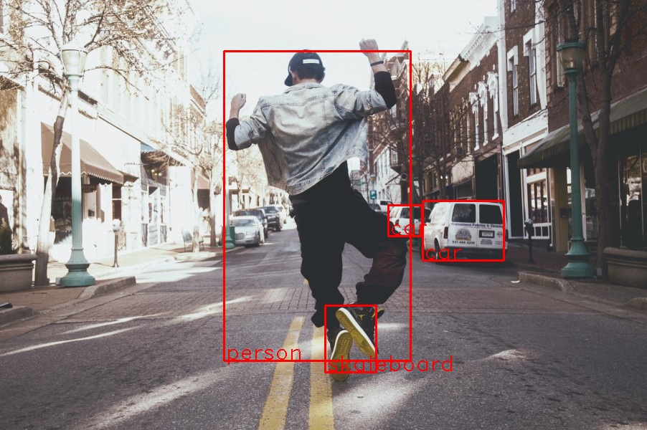
Image source: unsplash. Annotated by myself using yolo2

Slide 76
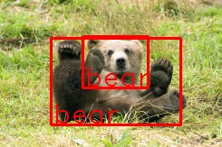
Image source: Deeplearning4j Animal Classification Dataset. Annotated by myself using yolo2

Slide 77
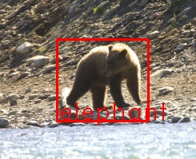
Image source: Deeplearning4j Animal Classification Dataset. Annotated by myself using yolo2

Slide 78
Sentiment Analysis
Approach:
Take an example and modify it
deeplearning4j.examples - ImdbReviewClassificationCNN.java
Get a new dataset from https://www.kaggle.com/kazanova/sentiment140

Slide 79
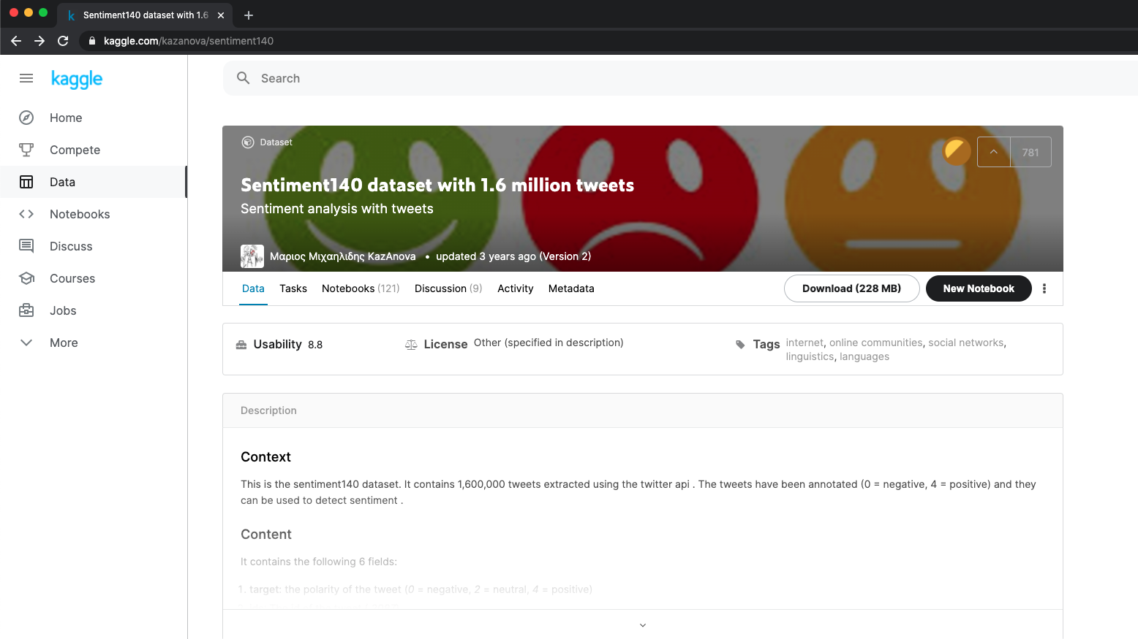

Slide 80
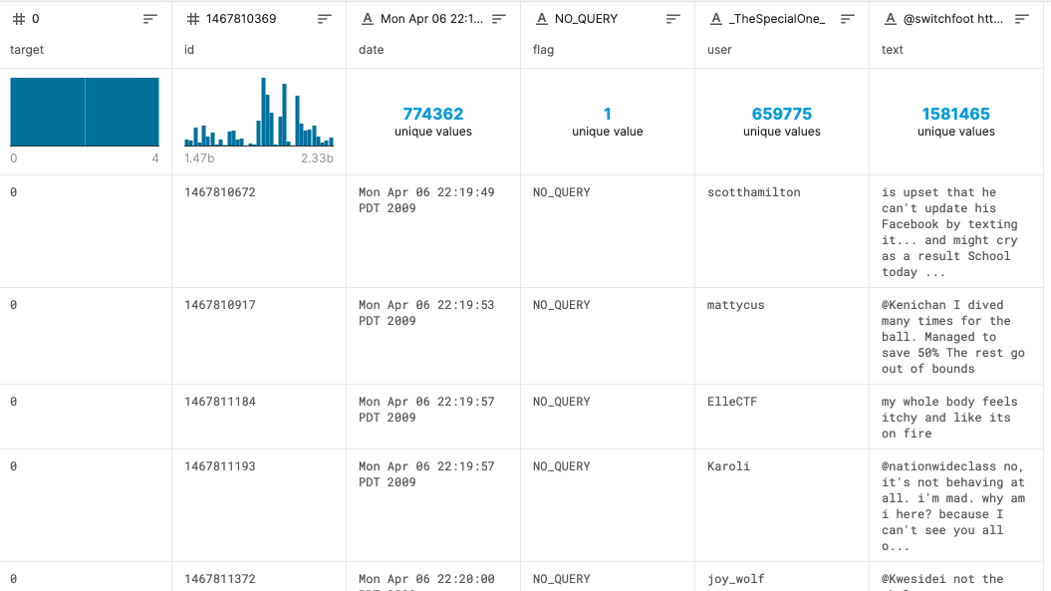

Slide 81
Overview
Load the word vectorizer
Load the dataset
Clean the dataset
Vectorize the words
Configure the model
Train the model
Evaluate the model
Export the model

Slide 82
Vectorizing words
Goal:
Transform the words into vectors (numbers) that the model can understand
Word2Vec
Two-layer neural network
Input: a corpus of text
Output: a vector space
Each unique word in the corpus is assigned a corresponding vector in the space
Source: Wikipedia, Word2vec, https://en.wikipedia.org/wiki/Word2vec , retrieved 08.2020

Slide 83
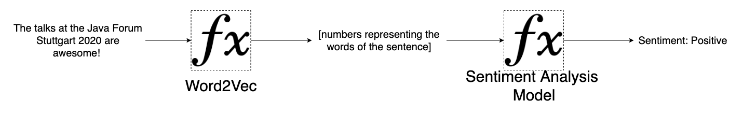
Vectorizing words

Slide 84
Sentiment Analysis – Most Valuable Code

Slide 85
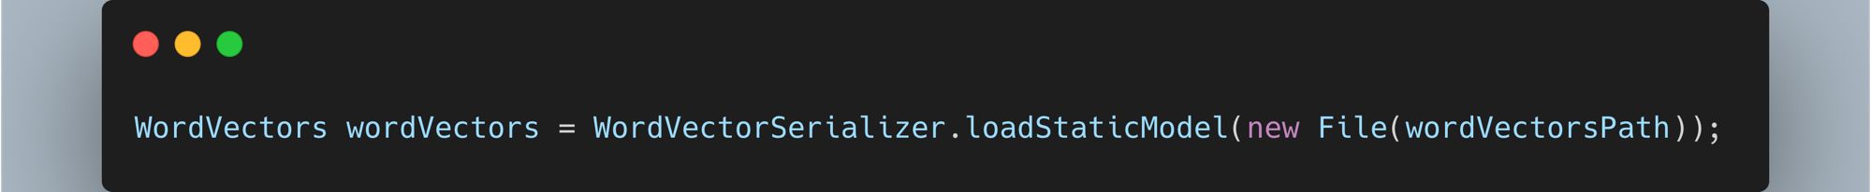
Load the word vectorizer
Load the dataset
Clean the dataset
Vectorize the words
Configure the model
Train the model
Evaluate the model
Export the model
Goal:
Transform the words into vectors (numbers) that the model can understand
This is loading a trained Word2Vec model from Google, can be downloaded from https://dl4jdata.blob.core.windows.net/resources/wordvectors/GoogleNews-vectors-negative300.bin.gz
Example to train your own word2vec model at SimpleExampleWord2Vec.java at https://github.com/ellerenad/deeplearning4j-playground

Slide 86
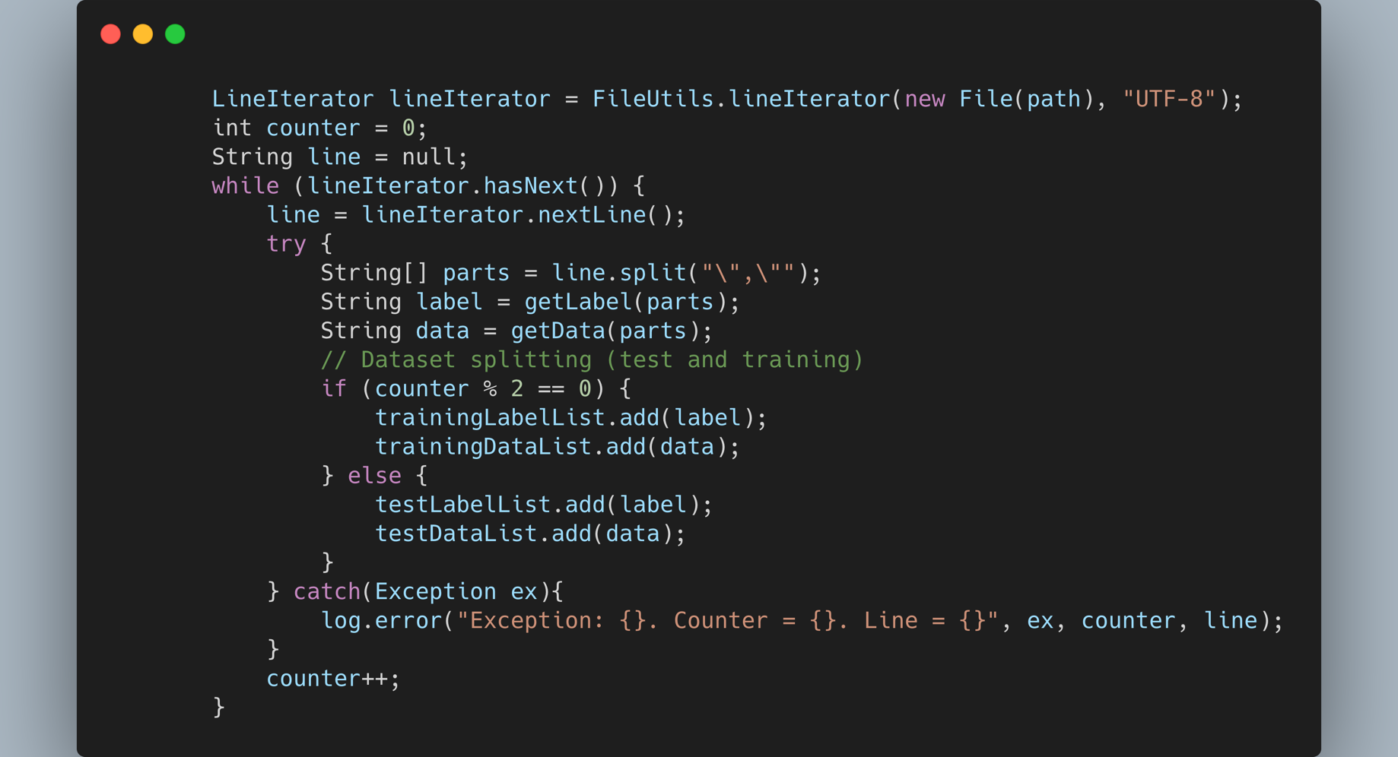
Load the word vectorizer
Load the dataset
Clean the dataset
Vectorize the words
Configure the model
Train the model
Evaluate the model
Export the model

Slide 87
Load the word vectorizer
Load the dataset
Clean the dataset
Vectorize the words
Configure the model
Train the model
Evaluate the model
Export the model

Slide 88
Load the word vectorizer
Load the dataset
Clean the dataset
Vectorize the words
Configure the model
Train the model
Evaluate the model
Export the model

Slide 89
Load the word vectorizer
Load the dataset
Clean the dataset
Vectorize the words
Configure the model
Train the model
Evaluate the model
Export the model

Slide 90
Load the word vectorizer
Load the dataset
Clean the dataset
Vectorize the words
Configure the model
Train the model
Evaluate the model
Export the model

Slide 91
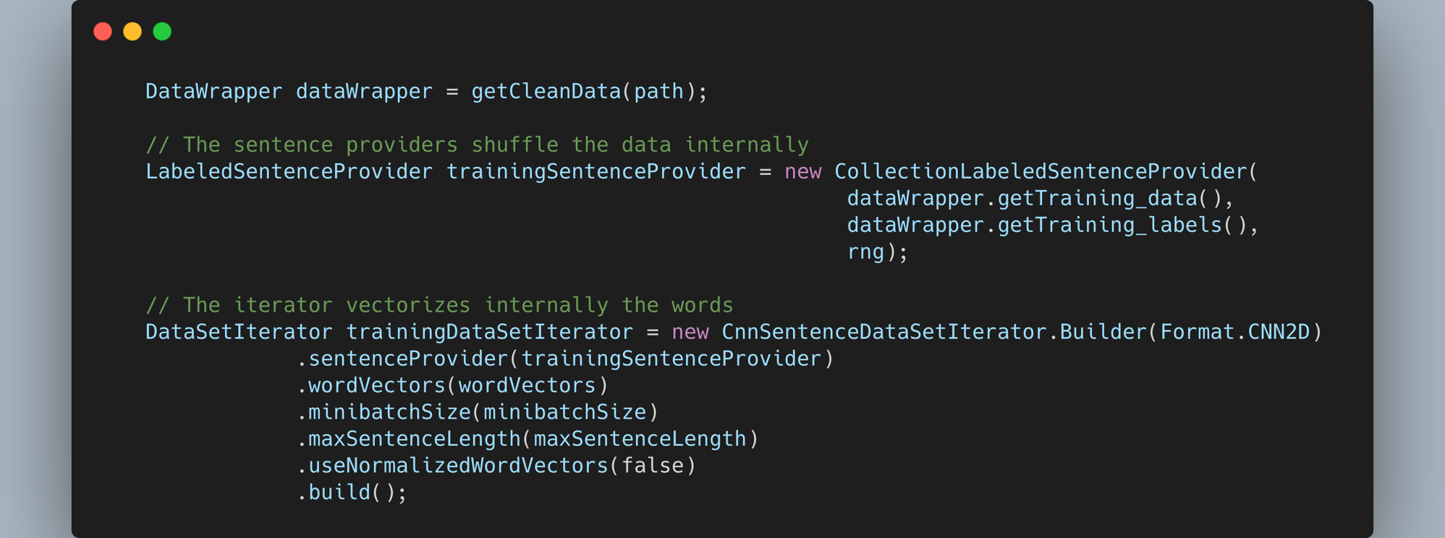
Load the word vectorizer
Load the dataset
Clean the dataset
Vectorize the words
Configure the model
Train the model
Evaluate the model
Export the model

Slide 92
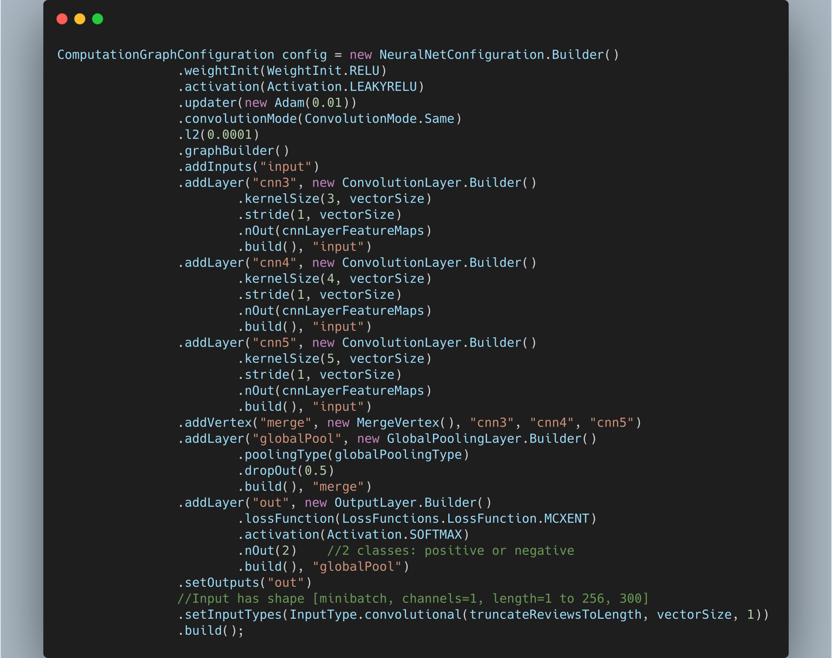
Configure the model

Slide 93
Vectorizing words

Slide 94
Configure the model

Slide 95
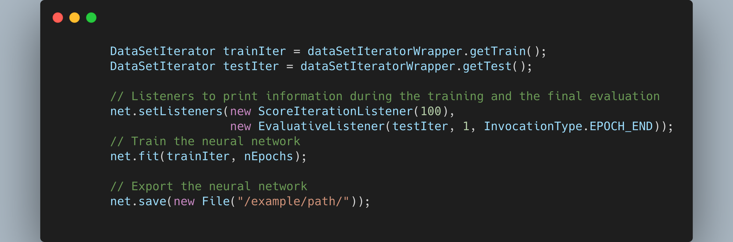
Load the word vectorizer
Load the dataset
Clean the dataset
Vectorize the words
Configure the model
Train the model
Evaluate the model
Export the model

Slide 96
Sentiment analysis prediction example
“this code is driving me crazy! what was this guy thinking!? *Annotates the code* oh... it was me”
P(Negative) = 0.72
P(Positive) = 0.28 Label: Negative

Slide 97
Problems during development
Slow feedback
Memory management
Loading the dataset

Slide 98
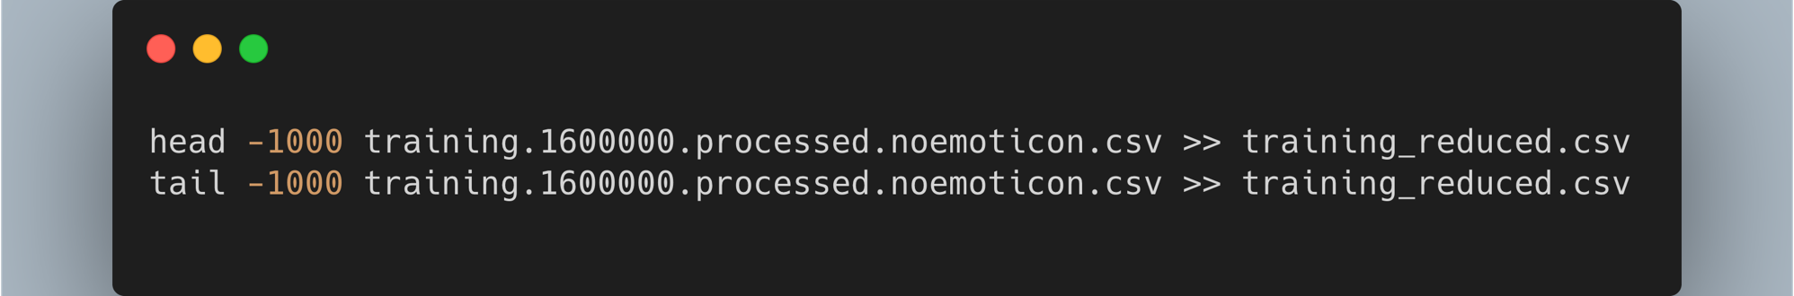
Sampling for faster feedback

Slide 99
Comparing results
Samples: 800000
Samples: 2000
40x
Accuracy | 0.7472
Precision | 0.7200
Recall | 0.8065
F1 Score | 0.7608
Execution Time | 1581209 ms
 | ~26.3 min
Accuracy | 0.6721
Precision | 0.6382
Recall | 0.7886
F1 Score | 0.7055
Execution Time | 165002 ms
 | ~2.75 min
10x

Slide 100
Comparing results
Samples: 2000
Accuracy | 0.6721
Precision | 0.6382
Recall | 0.7886
F1 Score | 0.7055
Execution Time | 165002 ms
 | ~2.75 min
Loading the word vectors: 154804 ms
~2.58 min

Slide 101
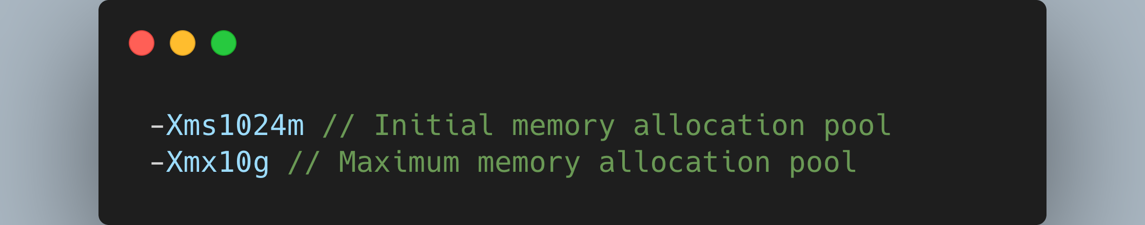
Memory Management
Tweak the JVM with the params:
More details at: https://deeplearning4j.konduit.ai/config/config-memory

Slide 102
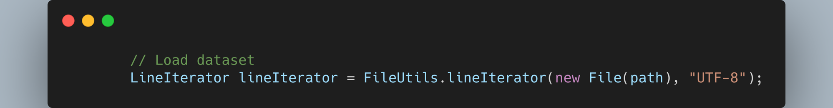
Load the data set
On files bigger than 40,000 lines, the java.util.Scanner would read just up to the half of the file, messing with the training.

Slide 103
Image source: Photo by dylan nolte on Unsplash

Slide 104

Thanks! Questions?
Quiz for the raffle!
All the code can be found at
https://github.com/ellerenad/deeplearning4j-playground
Enrique Llerena Dominguez
Twitter @ellerenad
Github @ellerenad
enrique.dominguez@mimacom.com

